Slide 1
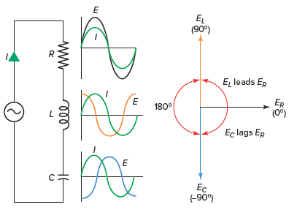
R
L
C

Slide 2

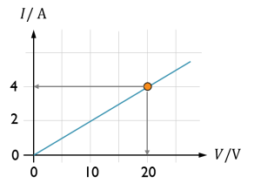
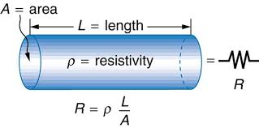
resistors
V = IR

Slide 3
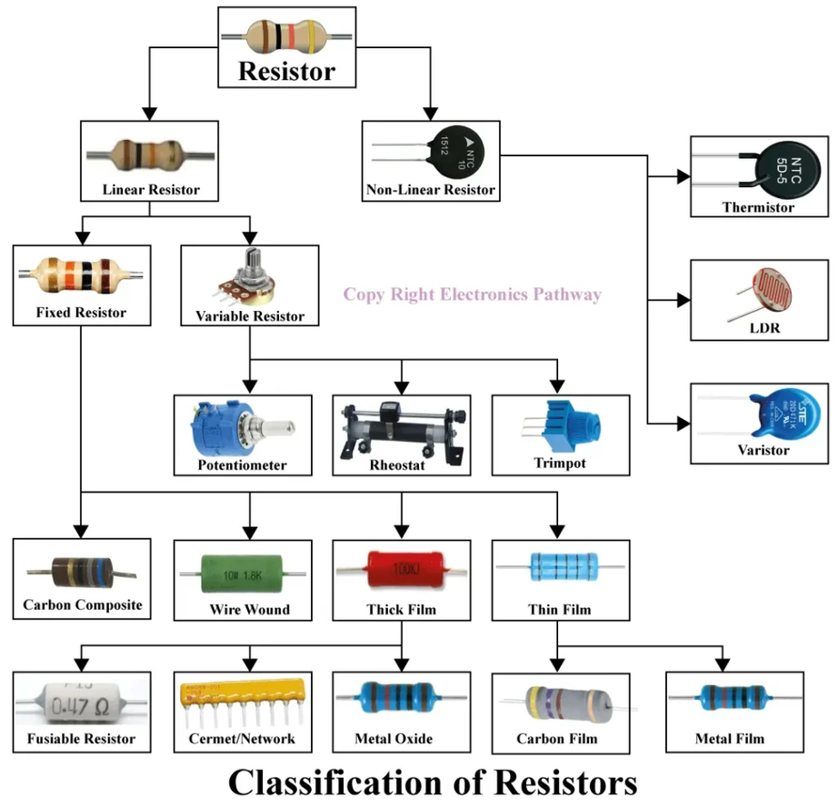
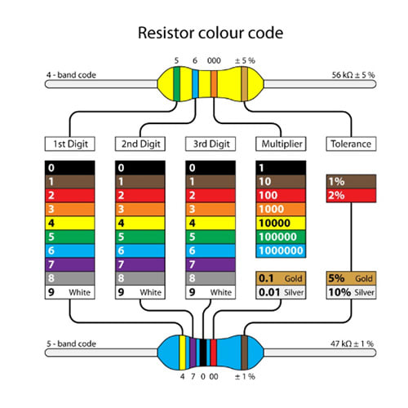
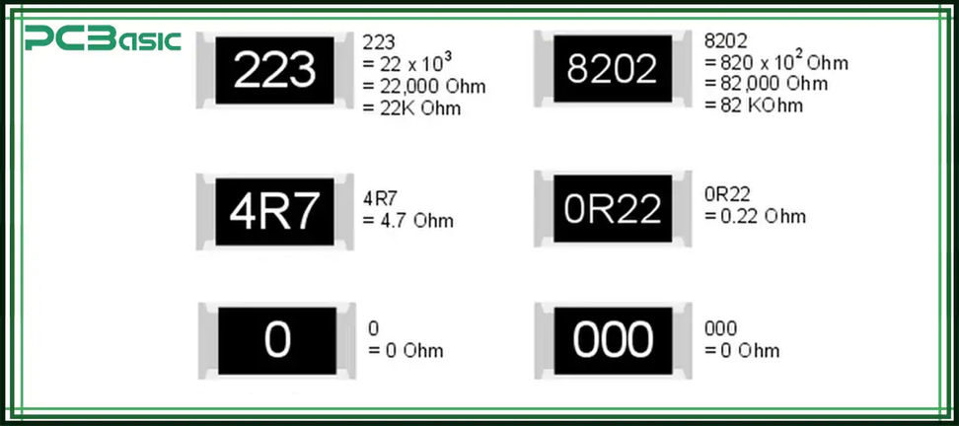

Slide 4
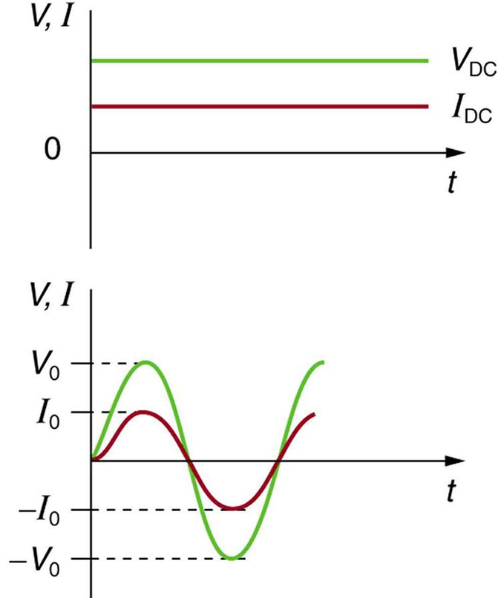
with DC
with AC

Slide 5
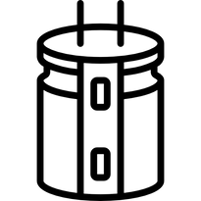
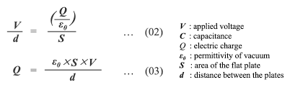
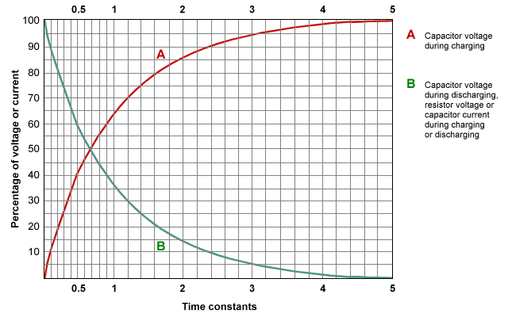
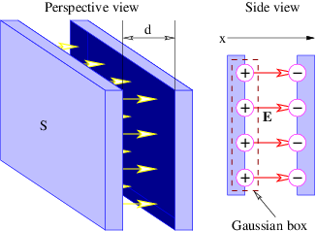
capacitors

Slide 6
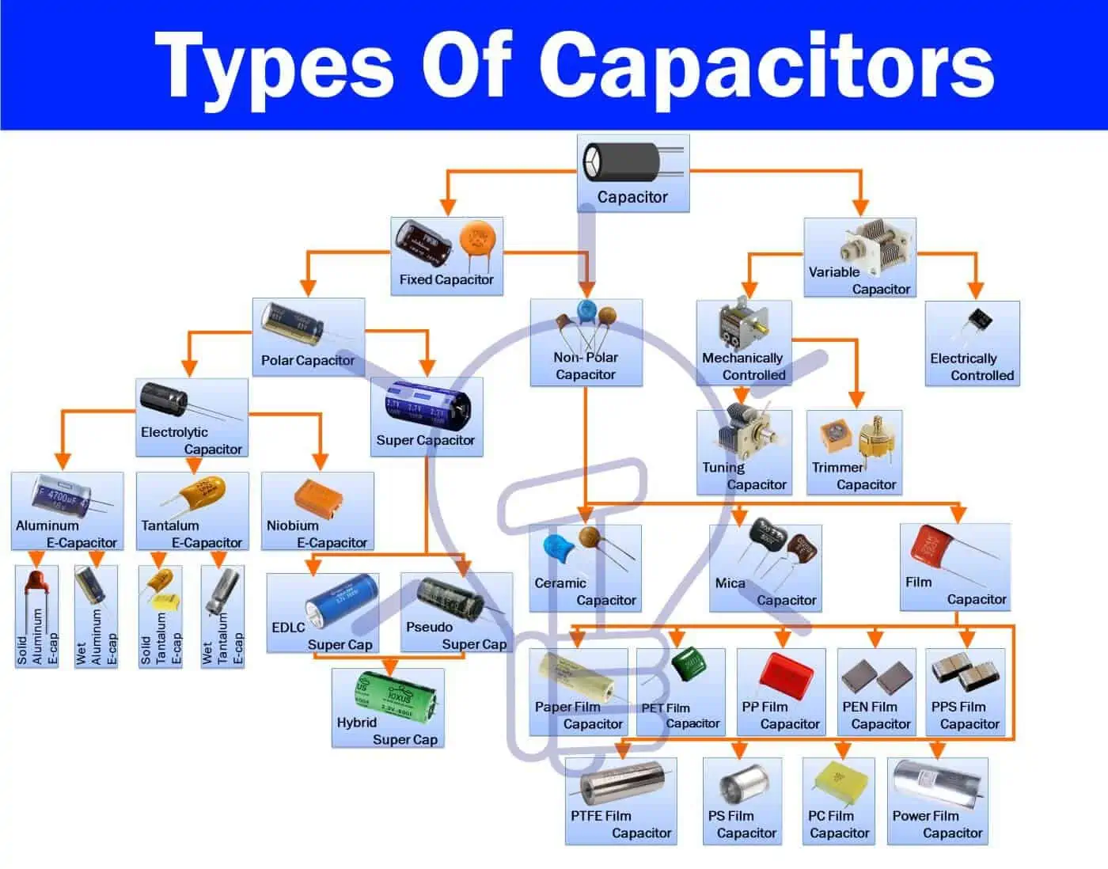

Slide 7
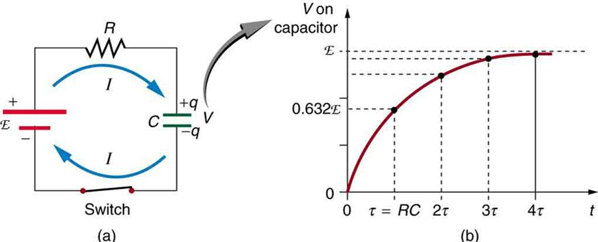
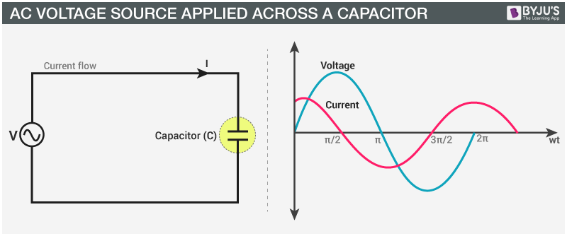
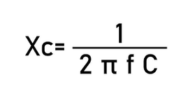
In a DC circuit, after the capacitor is fully charged, it acts as an open circuit, and current doesn't flow in the circuit
In AC circuits, a capacitor allows current to flow by continuously charging and discharging, causing current to lead voltage by 90°.

Slide 8
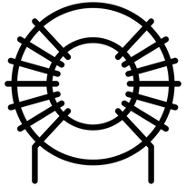
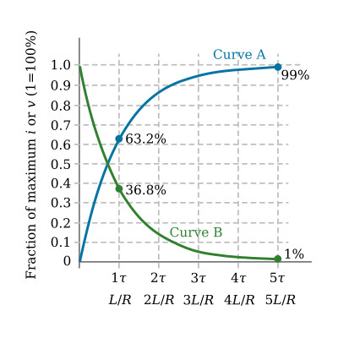
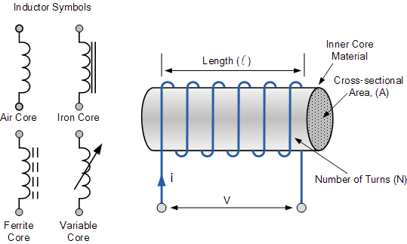
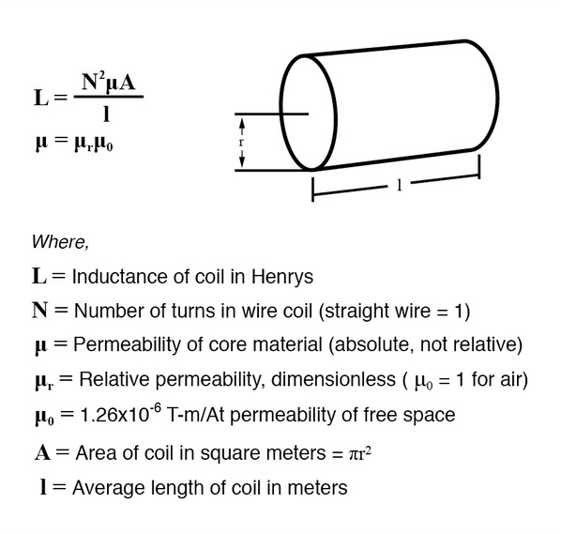
Inductors

Slide 9
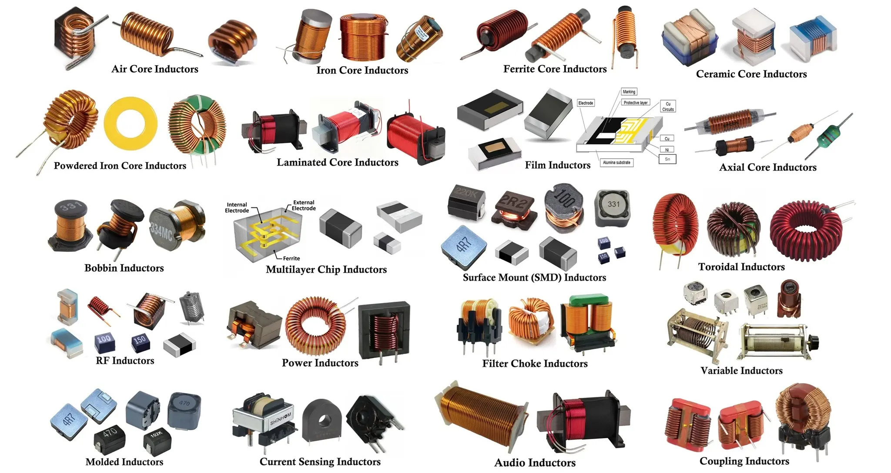

Slide 10
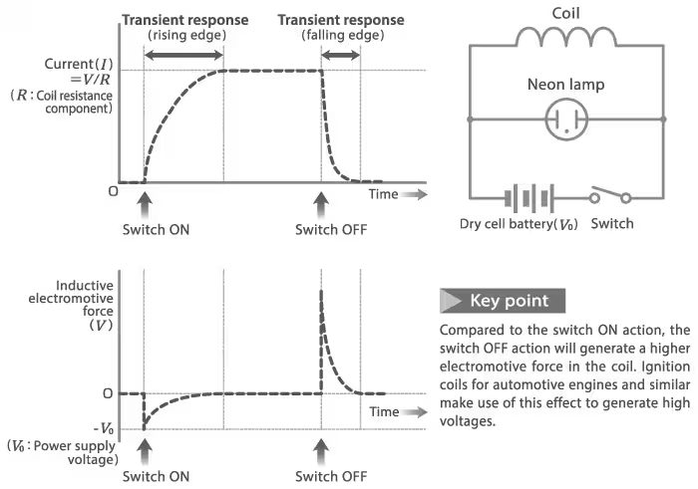
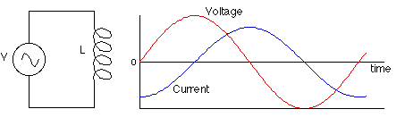

In a DC circuit, a coil prevents an instant change in current, so when the circuit is closed, the coil causes the current change slowly. When the current reaches its max, the coil acts as close circuit
In AC circuits, a coil resists changes in current, causing current to lag behind voltage by 90°.

Slide 11
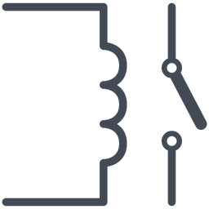
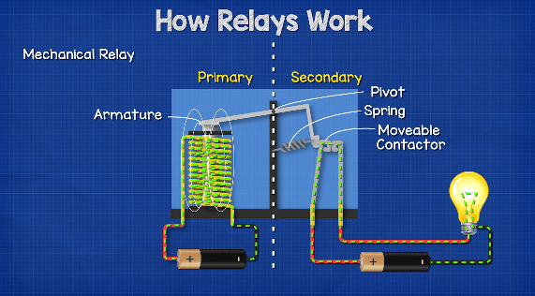
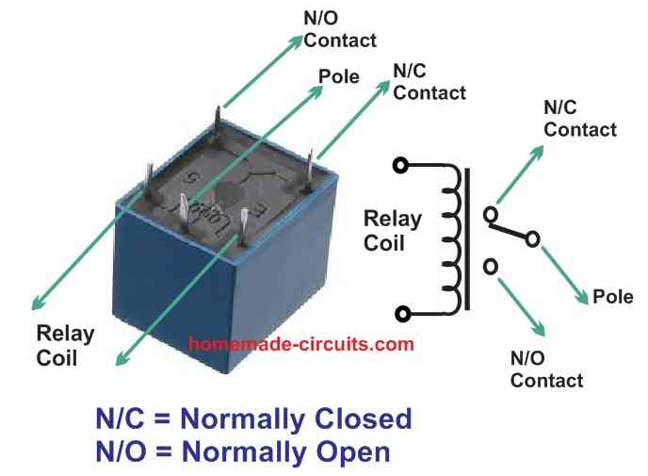
Relay
A relay is an electrically operated switch controlled by a small current. When the relay coil is energized, it produces a magnetic field that pulls the armature. This movement changes the contact position, closing the normally open (NO) contact and opening the normally closed (NC) contact. In this way, a low-power control circuit can safely switch a high-power load.

Slide 12
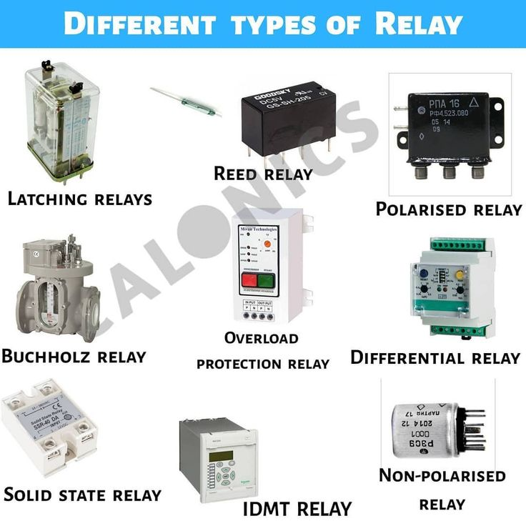

Slide 13
Thank you

